Slide 1

Development Individual Project: Presentation Multi-Agent Digital Forensics System
University Of Essex
14/10/2024
Student ID = 12694996

Slide 2
Index of contents
Introduction
Overview
System design
Agents breakdown
Implementation
Testing
Challenges
Future enhancements
Conclusion
References

Slide 3
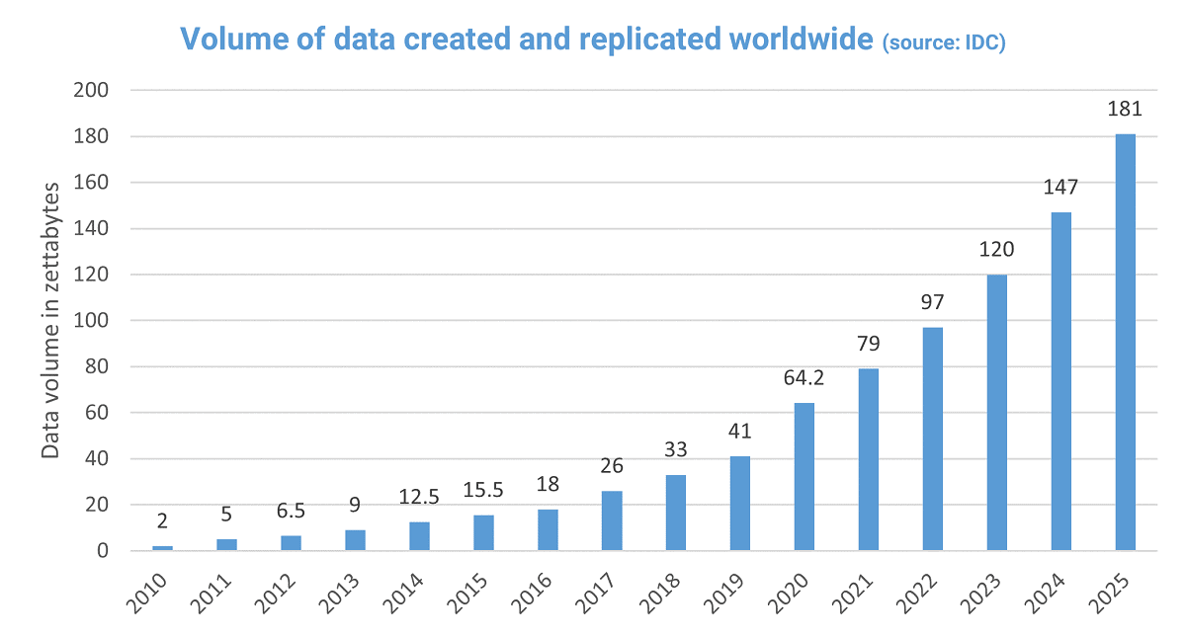
INTRODUCTION
The average usage of data has grown significantly
The project aims to automate digital forensics tasks.
A multi-agent system to identify, verify, and report file types on a digital forensic system.
Image 1: Total data created worldwide by year

Slide 4
overview
Technologies:
Python
Libraries:
SpaCy
Transformers
MimeTypes
Techniques:
Natural language processing(NLP}
KQML protocol

Slide 5
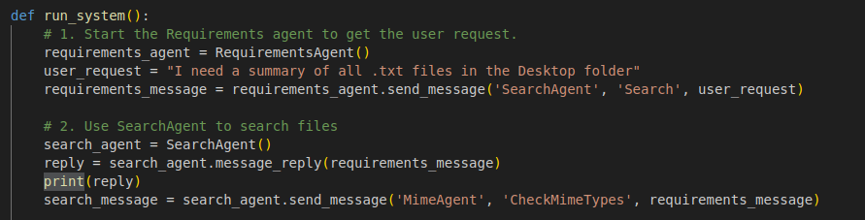
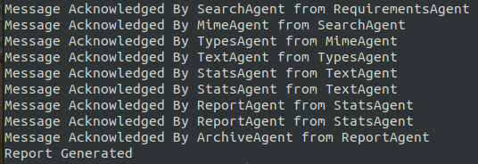
SYSTEM DESIGN
Variety of agent types
Each has a specific task to complete
Executed in sequence
Communicate using KQML protocol
Image 3: Agents message replies
Image 2: taskExecutor file

Slide 6
AGENTS BREAKDOWN
Agent 1 (Requirements)
Agent 2 (Search)
Agent 3 (MIME Validation)
Agent 4 (Text Summarization)
Agent 5 (Statistics):
Agent 6 (Report)
Agent 7 (Archive)

Slide 7
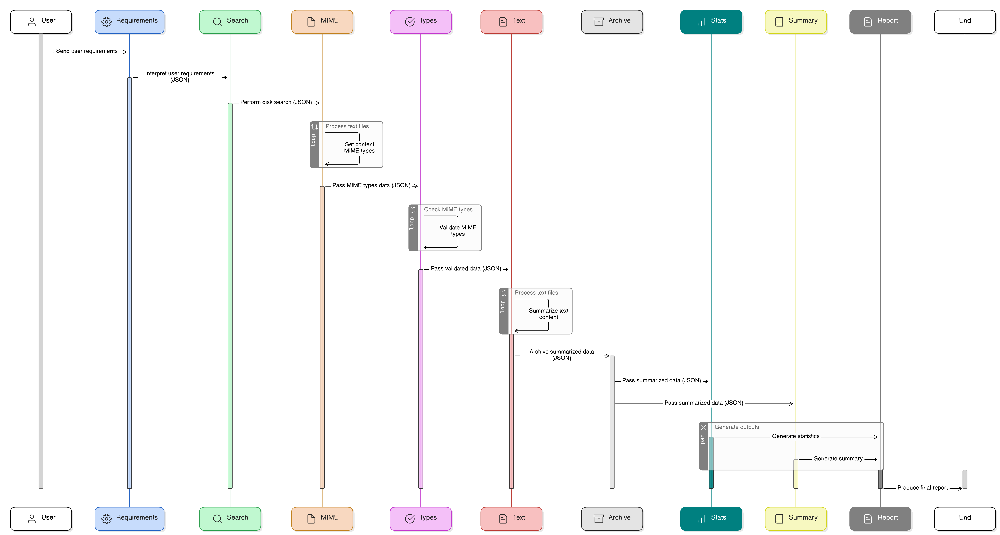
Image 4: system UML diagram

Slide 8
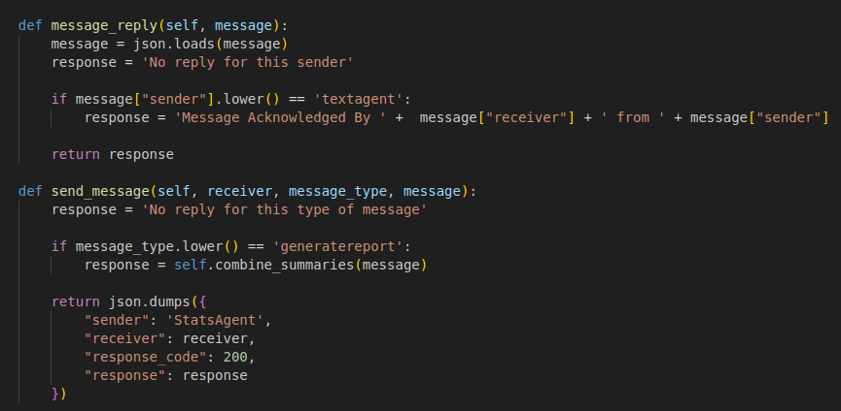
Implementation
Libraries in Libraries folder
AgentsCycleExecutor.py
Agent{Name}.py
Simple Ask/reply KQML
Reports saved in SavedReports folder
Error handling:
- invalid types
- invalid messages/senders
- empty files
- empty folders
Image 5: KQML messaging implementation

Slide 9
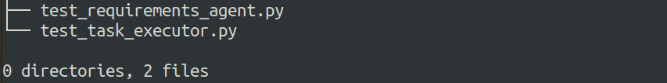
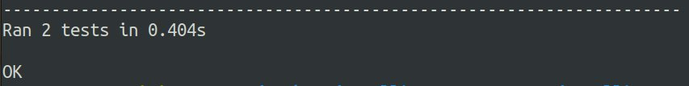
UNIT Testing
TaskExecutor/RequirementsAgent​
Test a valid run​
Test folders with no text files
Image 6: The current system tests
Image 7: Test run output

Slide 10
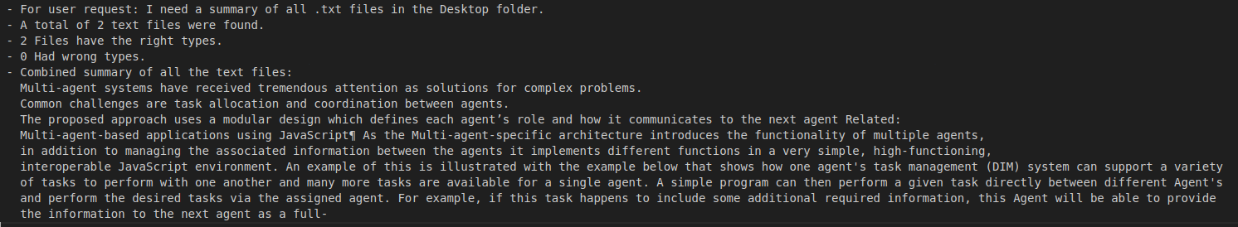
Smoke Testing
Image 8: Testing folder with 2 files
Image 9: Testing folder with no files

Slide 11
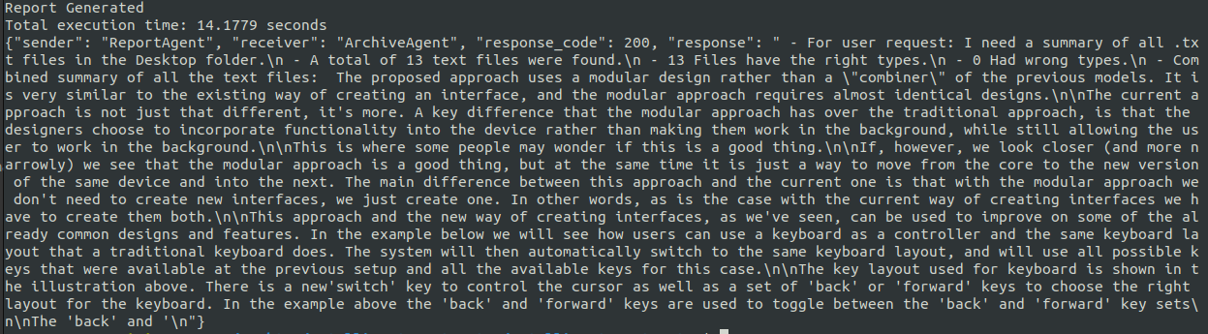
Challenges
Long waiting times when there is large number of files .
Running sequence issues when one agents returns invalid data or errors .
Different permissions on the files and folders.
Dependency on external libraries.
Image 10: Run execution final output

Slide 12
Future Enhancements
Use advanced AI modules to improve the automated tasks​.
Include more directories and filetypes to the filters​.
Add locking to prevent another agent from running if the pervious one failed or is still being executed​.
Add more KQML message types: ask if, preprocess...
Archive Errors & send alerts.

Slide 13
Conclusion
The impact of intelligent agents on digital forensics.
Multi-agent system for digital forensics​.
Testing the prototype​
Challenges arise​.
Future enhancements such as locking and ​

Slide 14
Questions & answers

Slide 15
References
Ademu, I., et al. (2010) ‘National Conference on Research Trends in Computing Science and Technology, India’. Available from https://www.researchgate.net/profile/Inikpi-Ademu/publication/266794110_National_Conference_on_Research_Trends_in_Computing_Science_and_Technology_India/links/543bd3430cf204cab1db3c2d/National-Conference-on-Research-Trends-in-Computing-Science-and-Technology-India.pdf [Accessed 11 October 2024].
Mastel, T. (2014) ‘Investigating the Future Internet: A Comparative Study’. Future Internet, 6(3): 584-597. DOI: https://doi.org/10.3390/fi6030584 [Accessed 12 October 2024].
Pires, D., et al. (2020) ‘Novel Approaches in Computational Hydrology’. WIREs Water. Available from https://wires.onlinelibrary.wiley.com/doi/epdf/10.1002/wfs2.1418 [Accessed 12 October 2024].
Ghazinour, K. et al (2017) ‘A Study on Digital Forensic Tools’, IEEE International Conference on Power, Control, Signals and Instrumentation Engineering (ICPCSI). 21-22 September. DOI: https://doi.org/10.1109/ICPCSI.2017.8392304
Labrou, Y. & Finin, T. (1994) A semantics approach for KQML—a general purpose communication language for software agents. CIKM '94: Proceedings of the third international conference on Information and knowledge management: 447-455. DOI: https://doi.org/10.1145/191246.191320
Al_Kholy, M.S., Khalifa, A.R. & Alsaied, M.G. (2010) A Systematic Approach for Mobile Agent Design Based on UML. Journal of American Science 6(12): 284-290. Available from https://www.jofamericanscience.org/journals/am-sci/am0612/32_3283am0612_284_290.pdf [Accessed 10 october 2024].

